Slide 1


Introduction to Social Selling
September 2016

Slide 2
Setting the Scene

Slide 3

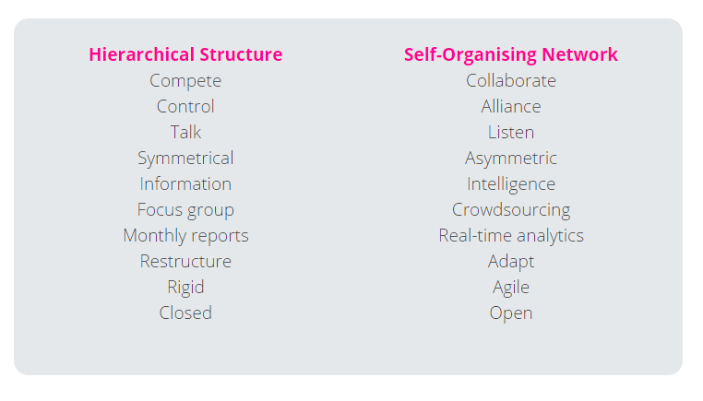
Companies are Changing

Slide 4
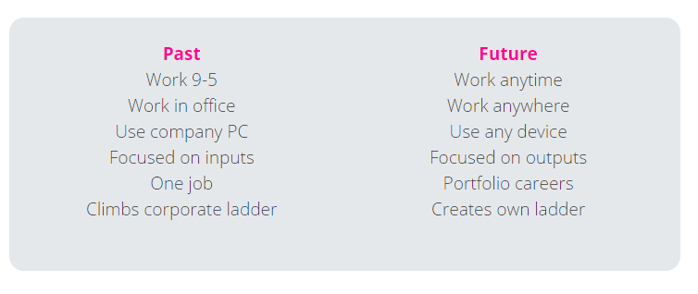
Employees are Changing

Slide 5

Customers are Changing

Slide 6
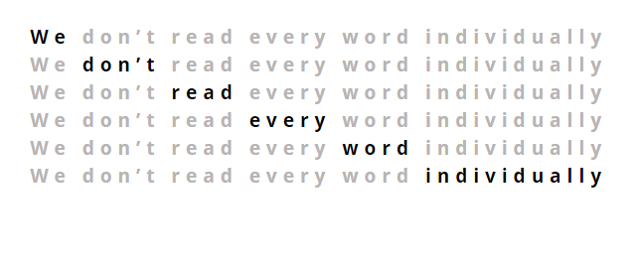
Information is Changing

Slide 7
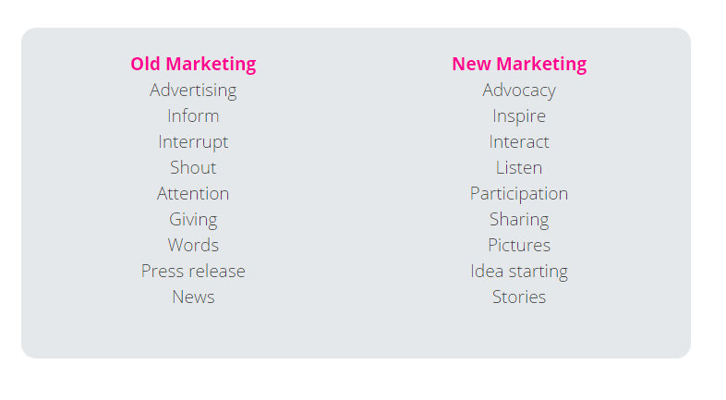
Marketing is Changing

Slide 8
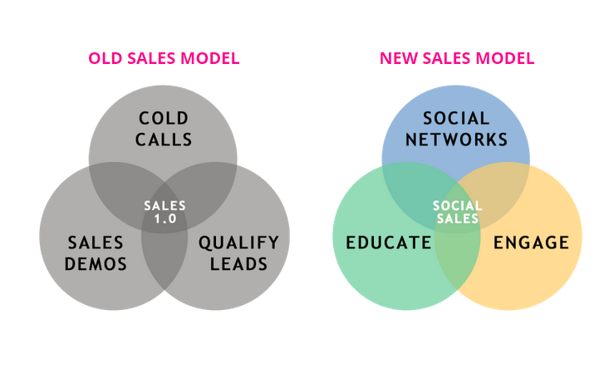
Sales is Changing
Losing Effectiveness
Cold calls
Direct mail
Printed brochures
Email marketing
Speculative meetings
Advertising
Gaining Effectiveness
Real-time engagement
Relationship building
Authentic personal brand
Advocacy
Right data, right time

Slide 9
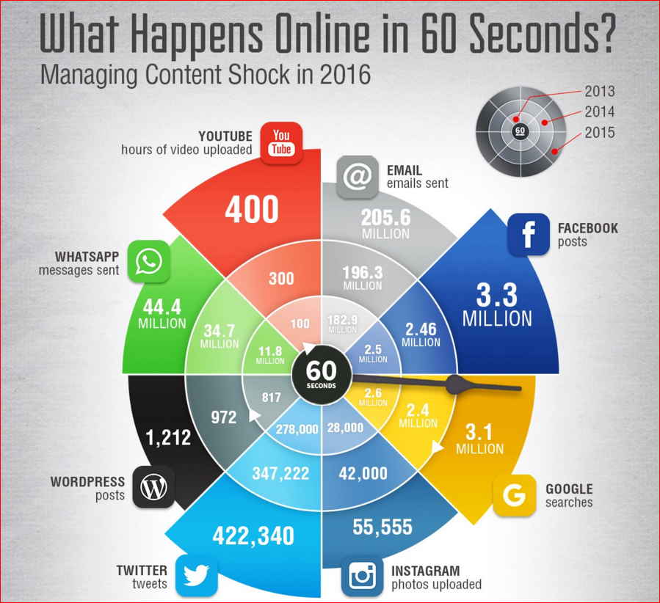

Slide 10
What is Social Selling?

Slide 11
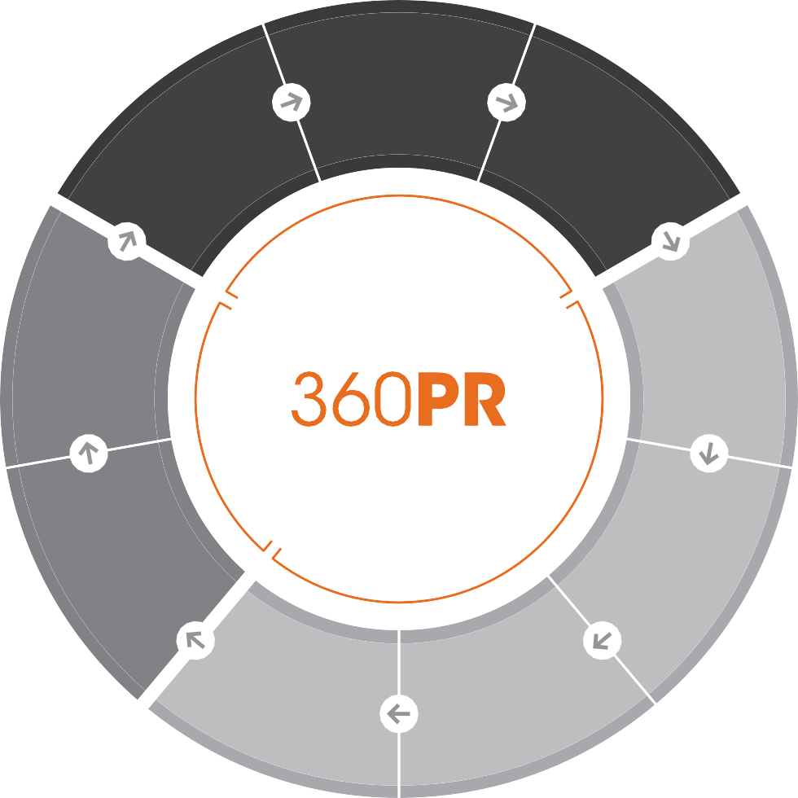
360PR: The Complete Perspective
STRATEGY
Delivery
Understanding your business objectives, target audiences and desired market positioning.
Performance Targets
Measurement
V
I
D
E
L
E
R
Y
Campaign Channels
Business Objectives
TACTICS
T
Creative. Define inventive campaigns based on strategic intelligence, using a broad set of tools, techniques, channels and content.
A
C
T
I
C
S
Y
G
Campaign Content
E
Target Audiences
T
S
T
R
A
DELIVERY
Desired Perceptions & Messaging
Desired Behaviours
Results-Driven. Set targets, guarantee commitments, deliver and showcase ROI.

Slide 12
What is Social Selling?
Listening to and understanding your market, customers, partners, competitors and prospects
Developing your personal brand on social media channels (e.g. LinkedIn, Twitter & Facebook)
Curating content and ideas relevant to industry issues and also targeting specific content to meet identified needs
It does not replace traditional professional sales skills, it enhances them. You become a trusted subject matter expert
Build relationships and then influence those relationships through engagement
It’s not hard sell, it’s about finding natural and authentic trigger points for relationship building

Slide 13
The Stats…
Sales reps who leverage social selling in their sales process are 79% more likely to attain their quota (Aberdeen Research Group)
Sales people using social media in their sales exceeded quota 23% more often (ASG Consulting)
78% of salespeople using social media outsell their peers (Forbes)
Social selling leaders have 45% more sales opportunities (LinkedIn)
54% of those using social selling have closed a deal as a direct result of social media (ASG Consulting)
75% of B2B decision makers and 84% of C-level and VP executives use social media to inform their decisions (IBM)

Slide 14
Social Selling Journey
Manage, maintain and evolve social media profiles (Twitter, LinkedIn, Facebook etc.)
Digital Lead Generation
Revenue
Opportunity
Convert
Target
Capture
Engage
Identify
Prospect
Lead
Customer

Slide 15






Social Selling – The Approach
Lead Generation
Content
SOCIAL
Brand
Thought Leadership
Endorsement
Corporate
Solutions
Identify
Engage
Capture
Target
Convert

Slide 16
Social Selling in Practice

Slide 17

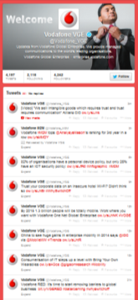
Case Study: Social Lead Generation
BRIEF
Increase lead generation and become an established online thought leader by using social media
APPROACH
Key targets and KPIs were agreed ahead of the campaign starting
VGE’s Twitter site was managed as the primary social channel to grow followers, influencers and share content
Tailored content - whitepapers, case studies, infographics - was created and shared across relevant social channels
The custom content required registration to download, generating named prospects to qualify as leads
Tracking codes on all content was compliant with VGE’s CRM and sales automation systems
Tracking and analytical tools enabled content to be measured for effectiveness
RESULTS
Over 150 high quality MQLs were passed from VGE’s marketing team to sales
Targeting high level influencers with engaging content established client as industry thought leader
Increased VGE’s Twitter following by 130%
Increased VGE web traffic from social channels by 120%
Campaign successfully achieved KPIs during initial trial period and was extended into an annual programme
CASE
STUDY
Client
Vodafone Global Enterprise (VGE)
Project
Social Media Lead Generation
Industry
Telecoms
Headline Results
150+ Qualified Sales Leads
130% Increase In Twitter Following
120% Increase In Web Traffic

Slide 18

Case Study: Digital by Default
BRIEF
Provide digital skills training to diplomats at the Foreign & Commonwealth Office (FCO)
To train and up-skill diplomats with the practical skills, confidence and understanding of digital tools - and also drive a more open organisational culture
Longer term aim was to accelerate this process and embed digital by default in all policy and communications processes
APPROACH
Devised, created and delivered digital media training courses that were practical in nature and focused on demystifying social media channels
The bespoke sessions showed delegates how to use social channels to achieve their individual policy and communications objectives
All diplomats were also taught how to use Hootsuite as a social media management dashboard
The courses were highly interactive, fun learning experiences – designed to meet the needs of course attendees, from real beginners to true digital natives
Tailored role plays and topical scenarios were created for each session
RESULTS
Over 300 diplomats trained in the first year
Course evaluation scores averaging 90%+ positive feedback
Diplomats have now embedded the use of digital tools in policy making and communications, truly transforming the FCO
Automatic renewal of the contract for a further years
CASE
STUDY
Client
Foreign & Commonwealth Office – Ongoing Contract
Project
Social Media Training
Industry
Government
Headline Results
300 diplomats trained
90%+ positive feedback
Diplomats now actively use social media for policy making and communications

Slide 19

Twitter
Real-time news feed
Twitter can be searched to identify customers, partners, competitors, prospects and industry news
These groups will often share news, views, ideas, links and documents that can assist your social selling strategy
Twitter Lists enable real-time intelligence feeds to be created by aggregating and categorising these groups

Slide 20
Twitter
Tweet often (at least 4 x a day)
Include links, photos and videos when you tweet
Share interesting and relevant third party content
Follow other people
Create Twitter lists of influencers
Subscribe to relevant public Twitter lists
Mention people
Retweet and favourite tweets
Use hashtags
Promote your account – add to all communication and tell all staff to do likewise
Respond to questions
Use Twitter ads

Slide 21
Social Selling – Triggers
Twitter has 9 social selling triggers:
Tweets
Retweets
Mentions
Follows
Added to lists
Replies
Likes
Messages
Hashtags

Slide 22
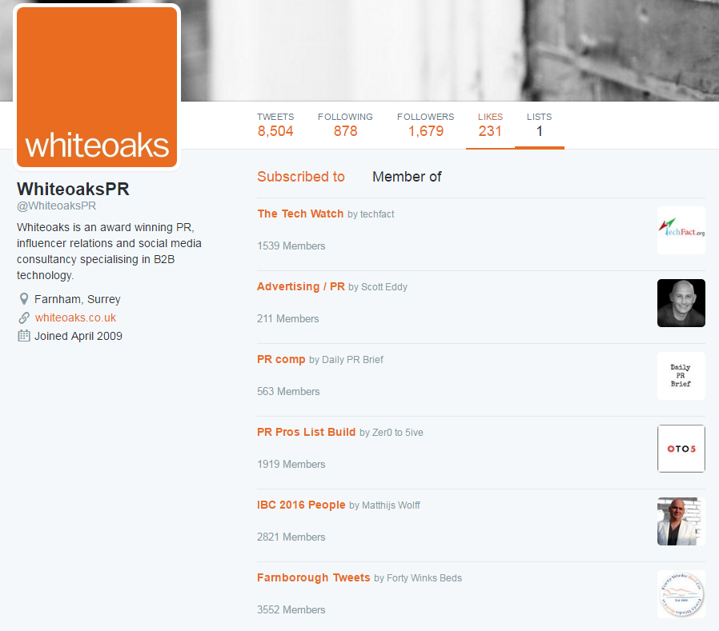
Twitter Lists

Slide 23

LinkedIn
Validate identities
Advanced search to identify prospects
Join and participate in business related groups
Datamining
Sharing content to build thought leadership
Targeted advertising
Sales Navigator and Social Selling Index (SSI)
Monitor competitors, partners and customers

Slide 24
LinkedIn
Post regularly (at least 1 x a day)
Create targeted content (videos, tips, discussion threads they can’t get anywhere else)
Provide a place for interaction
Respond to comments and feedback
Promote your account – add to all communication and tell all staff to do likewise
Share and like official company content, shares
Use LinkedIn ads
Reply to influencer posts

Slide 25
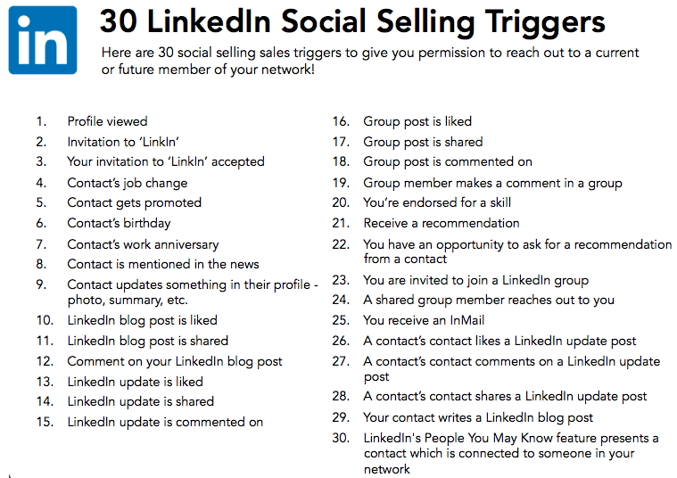
Social Selling – Triggers

Slide 26
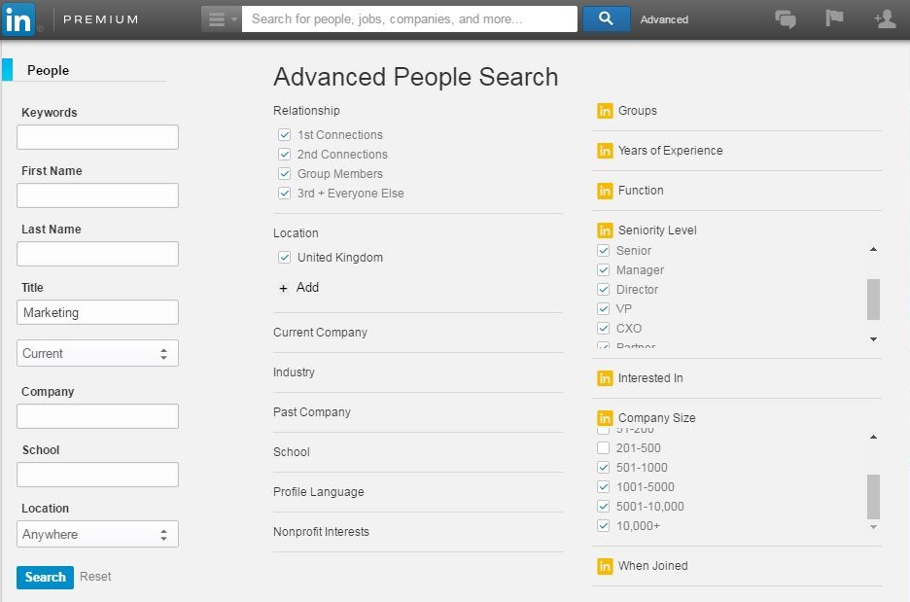
LinkedIn Advanced Search

Slide 27

Facebook
Facebook pages are for businesses, brands and organisations to share their stories and connect with people
A Facebook page makes your business:
Discoverable: When people search for you on Facebook, they'll be able to find you
Connected: Have one-to-one conversations with your customers, who can like your Page, read your posts and share them with friends
Timely: Your Page can help you to reach large groups of people frequently, with messages tailored to their needs and interests
Insightful: Analytics on your Page will give you a deeper understanding of your customers and your marketing

Slide 28
Facebook
Post regularly (at least 3 x a day)
Create targeted content (videos, tips, discussion threads they can’t get anywhere else)
Provide a place for interaction
Respond to comments and feedback
Promote your account – add to all communication and tell all staff to do likewise
Reciprocate likes
Use Facebook ads

Slide 29
Rules of Engagement
Do:
Be focused: define your niche
Be authentic & human
Be trustworthy & polite
Don’t self-promote
Be accessible and responsive
Be reciprocating
Share interesting content and ideas
Don’t:
Get drawn in to an online argument
Disclose information that is sensitive or privileged

Slide 30
Other Social Selling Tools
SocialRank
https://www.socialrank.com/
Organise and manage your followers
Hashtagme
http://hashtagify.me/
Identify popular hashtags
Trends24
http://trends24.in/
Detailed breakdowns of trending terms
Buzzsumo
https://app.buzzsumo.com/top-content
Type in a keyword to identify influencers/amplifiers who may want to share your content
DiggDeeper
http://blog.digg.com/post/91454524841/digg-deeper
Discover the top articles and links that your Twitter followees have shared – allows you to identify popular content/ideas
Swayy
http://www.swayy.co/#content
Analyse the topic interests of the people who follow you
Bluenod
http://bluenod.com/
Map and visualise the communities around a Twitter user or hashtag
My Top Tweet
https://mytoptweet.com/
Find any Twitter user's top ten tweets by engagement
Trendspottr
http://www.trendspottr.com/welcome.php
Find out what's trending around a topic or a list

Slide 31
Social Selling Journey
Manage, maintain and evolve social media profiles (Twitter, LinkedIn, Facebook etc.)
Digital Lead Generation
Revenue
Opportunity
Convert
Target
Capture
Engage
Identify
Prospect
Lead
Customer

Slide 32


